Slide 1
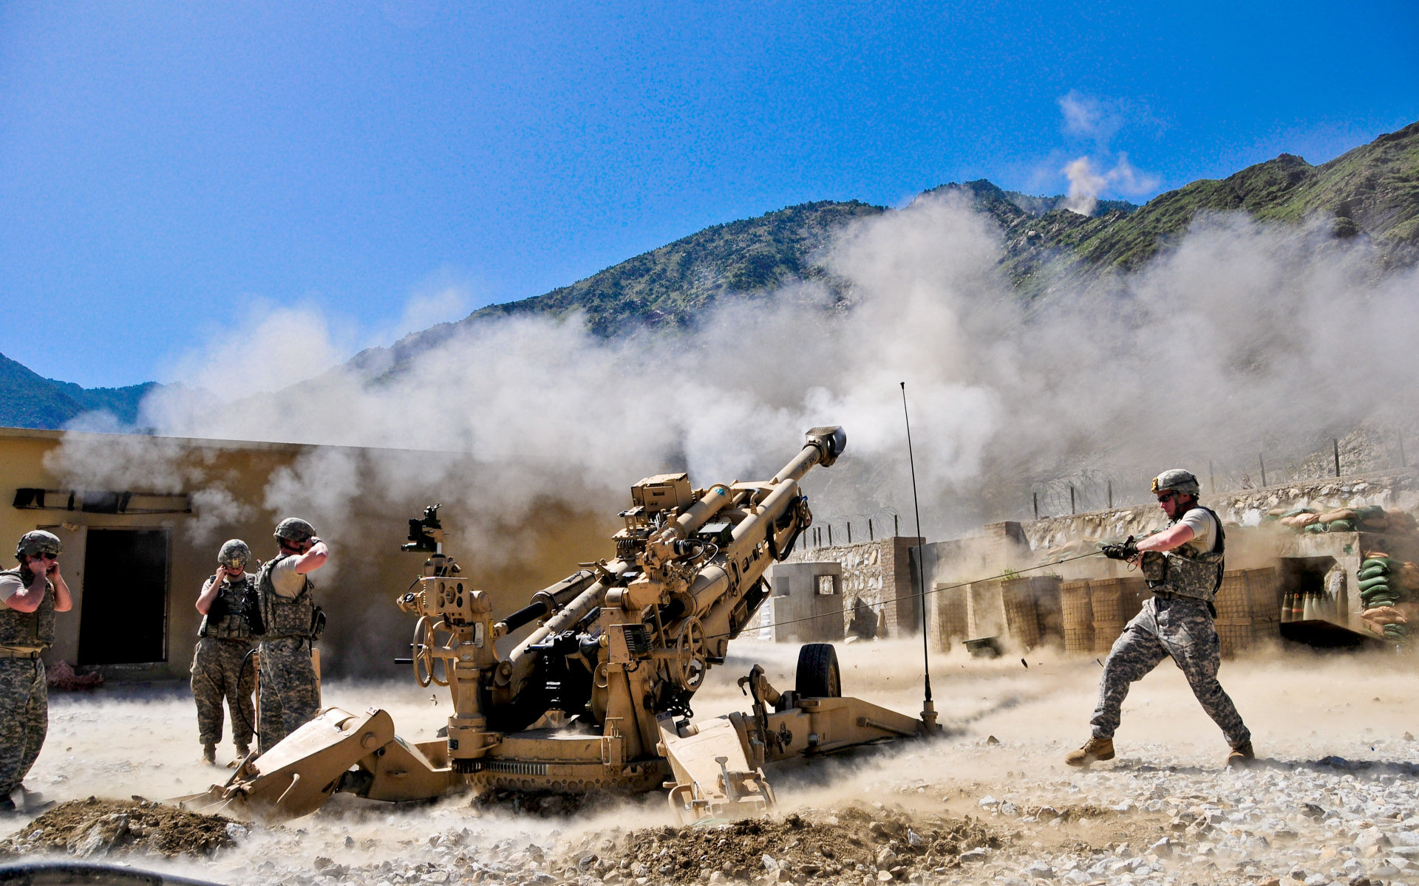
UAV With Integrated Observation System For Artillery Fire Guidance
BY MIST CSE-19

Slide 2
BACKGROUND
The Corps of Artillery also known as ‘GOD OF THE BATTLE’ plays a decisive role to dominate a war and win any battle.
During liberation war of 1971, Corps of Artillery was first raised in BD Army. The pioneer units of BD Army raised during liberation war are 1 Fd Regt Arty(Mujib Battery),2 fd Regt Arty(Raswanara Battery) & 3 Fd Regt Arty(Rocket Battery).
Presently Corps of Artillery is catagorize in two types : Field Artillery and Air Defence Artillery.

Slide 3
MOTIVATION
To get decisive success in battlefield practice in peace time is very crucial.
Presently the system which is followed to conduct practice fire is manual where an observer detects the impact points and send necessary feedback for correction and guidance of the subsequent fires.
However, in present system the error margin is high ,time consuming and takes more human effort.
Which motivated us to integrate modern technology in Artillery Practice Fire.

Slide 4
PRESENT SYSTEM & WORKING PRINCIPLE
When a shell is fired an observer who is positioned near to the target area tries to identify the impact points and sends feedback.
In observer’s feedback the approximate position of the hit is mentioned and if it is a blind shell the probable location of the shell is referenced for disposing by Engineer’s support.
According to the feedback, necessary adjustments are done to bring accurate fire on the target area.

Slide 5
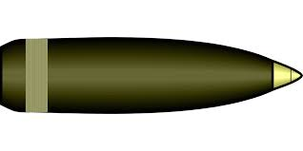
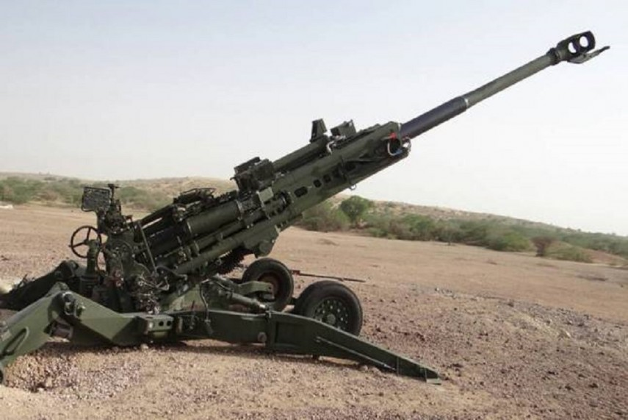

OBSERVER
RADIUS 300-400 m
TARGET OBJECT
DISTANCE
16/35/50 KM

Slide 6
MERITS OF EXISTING SYSTEM
Easy to implement.
Correction and detection proceudre is simple.
Training people is comparatively easier.
No modern technology/equipment is used.

Slide 7
DEMERITS OF EXISTING SYSTEM
Detection and feedback method is primitive.
Time consuming.
Takes more human effort.
Gross error margin.
Less efficient.

Slide 8
Proposed Solution
two steps: 1st phase and 2nd phase
1
System analysis, design and prototype implementation- mainly based on thermal camera only.
2
Integrated thermal camera and Drone based localization confirmation system will be implemented.

Slide 9
Our Initial Ideas
01
Using radar technology to detect the shell
02
Using high speed motion capture camera
03
Using thermal camera
04
Using thermal camera with drones

Slide 10
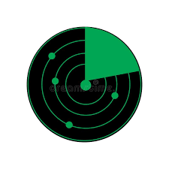
Our initial thought on using radar
Pros:
Highest Possible Accuracy
Using radar, we can pinpoint the exact location of the shell’s descend point.
Trajectory and Speed Detection
We can observe the trajectory and Speed of the shell using radar technology.
Cons:
Cost of Radar
The price of a radar is very costly. Also purchase, legal contract, shipping requires a lot of time making radar not feasible.
Installing the radar
Since our project takes place in a field which is repeatedly bombarded with shells from artillery fire, it becomes problematic to set up and configure the radar.

Slide 11
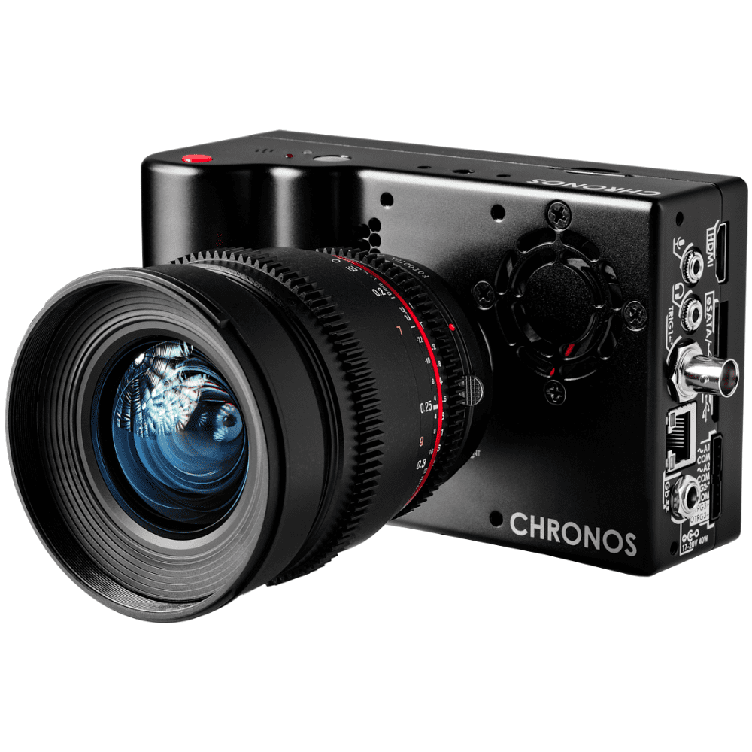
Using high speed motion capture camera

Slide 12
Pros and Cons of using motion capture camera
Cost Efficiency
The cost of a motion capture camera is much less than a radar or a thermal camera
Installation Benefits
Installing the motion capture camera in the field of testing is much easier and far more reliable.
Pros
Cons
Product dependency
Depending on the product, the image processing may or may not be able to appropriately locate the shell
Low Accuracy
Since we are locating the shell based on pure image processing, the accuracy might be lower than expected

Slide 13
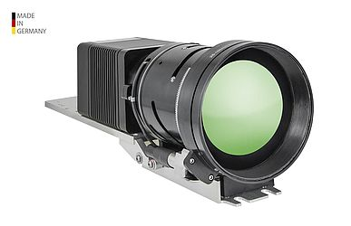
Using Thermal Camera

Slide 14
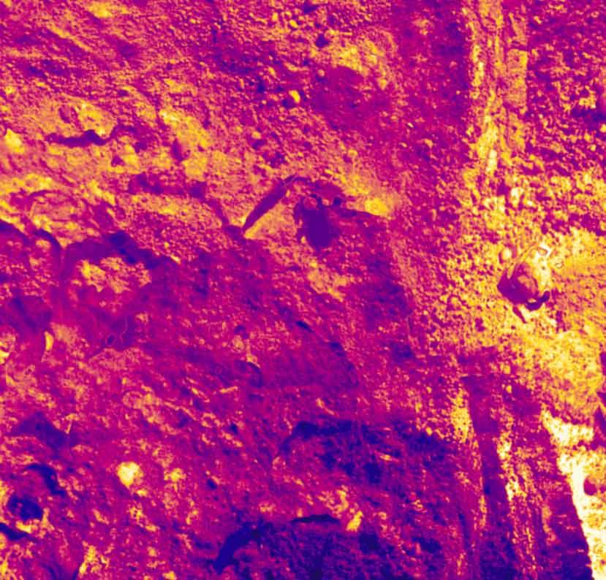
Image Provided By a Thermal Camera

Slide 15
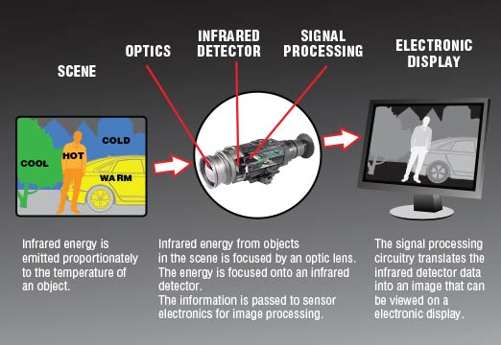

Slide 16
Thoughts on Using Thermal Camera
Pros
| | | | | | | | | | | | | | | | |
| |
Cons
The shell is easily detected due to the sheer heat the shell generates as it leaves the barrel.
As the shell explodes on site, we can determine if the target has been hit or missed.
In case of blind shell, we can detect the exact location of the spot as the shell leaves behind a huge heat signature.
Thermal image can detect even the slightest change in heat so the possibility of success increases drastically.
The price of a thermal camera is much higher than that of a high speed motion capture camera.
The quality of thermal image is equipment dependent and so results may vary depending on the type of equipment used during testing.
In built thermal camera in drones are harder to obtain than regular drones.

Slide 17
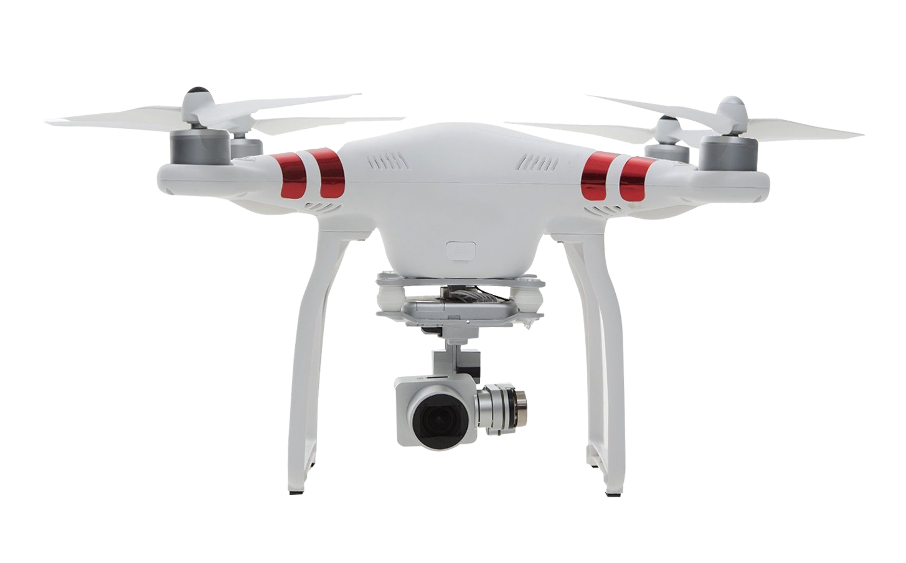
2nd Phase of Work: thermal camera with drones
Drones are controlled by remote ground control systems (GSC) and also referred to as a ground cockpit.

Slide 18
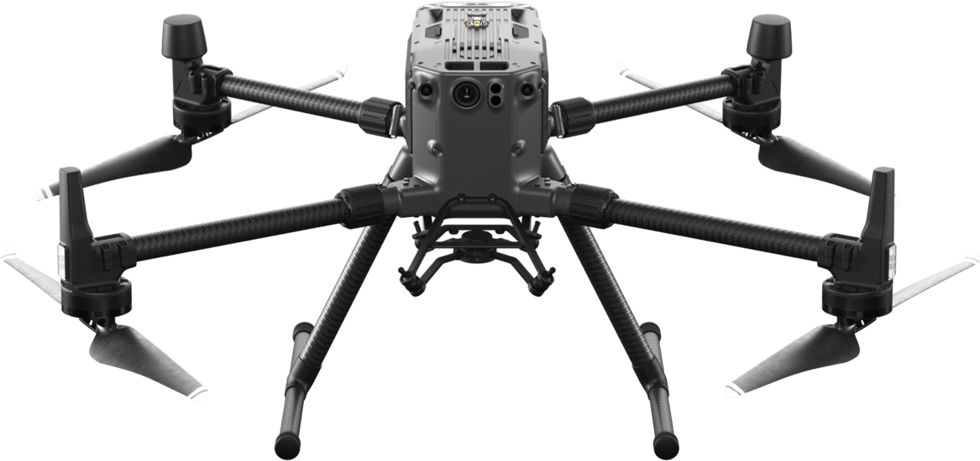
Our Preferred Drone
The Matrice 300 RTK sets a new standard for industrial drones by combining intelligence with high-performance and unrivaled reliability.
55 min Max Flight Time
15km 1080p map transmission
6 Directional Sensing and Positioning
-20°C to 50°C operating temperature
DJI Matrice 300 rtk

Slide 19



O1
Airborne stability very high.
Can easily hold its altitude and position.
It is very modular. We can easily attach various thermal cameras easily.
O2
Why we prefer this drone?
O3
It is a long lasting battery life and
an overall Max Flight Time of
55 min.
15km 1080p map transmission.
O4
O5
This drone is used in various
military and government purposes.
Overall bill quality is excellent.

Slide 20
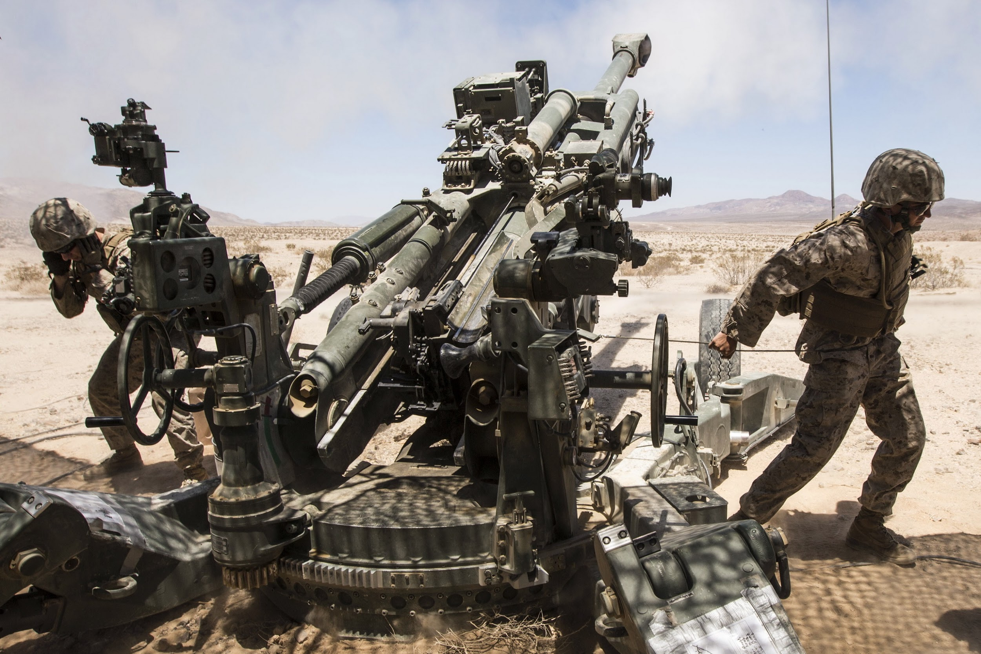
Methodology for Static Approach

Slide 21
Equipment for 1st phase
1st phase of our Project
is Static and does not involve the use of Drone
Thermal Imaging System
we are targeting to use a thermal sensor because of the significant heat signature of a fired shell
Our project deals with the artillery fire guidance and observation system therefore we are targeting to use a thermal sensor because of the significant heat signature of a fired shell. In the first phase, we will be skipping the part of UAVs or drones and will be using a thermal camera which is a static solution for the problem. If we are successful with the static approach then we will opt for the dynamic solution and introduce the UAV or drone. This report is all about the static solution with a thermal camera which phases one of this fire guidance project.
High Mast Lighting Pole
Equipment
we have to elevate the thermal camera system and for that, we are intending to use a High Mast Lighting Pole which can easily give us a ground clearance up to 30 meters.
For Static
testing
Computational Device
Our purpose
As this is a very sophisticated process and the workload is very high, we need good computational power for that.
For initial field testing

Slide 22
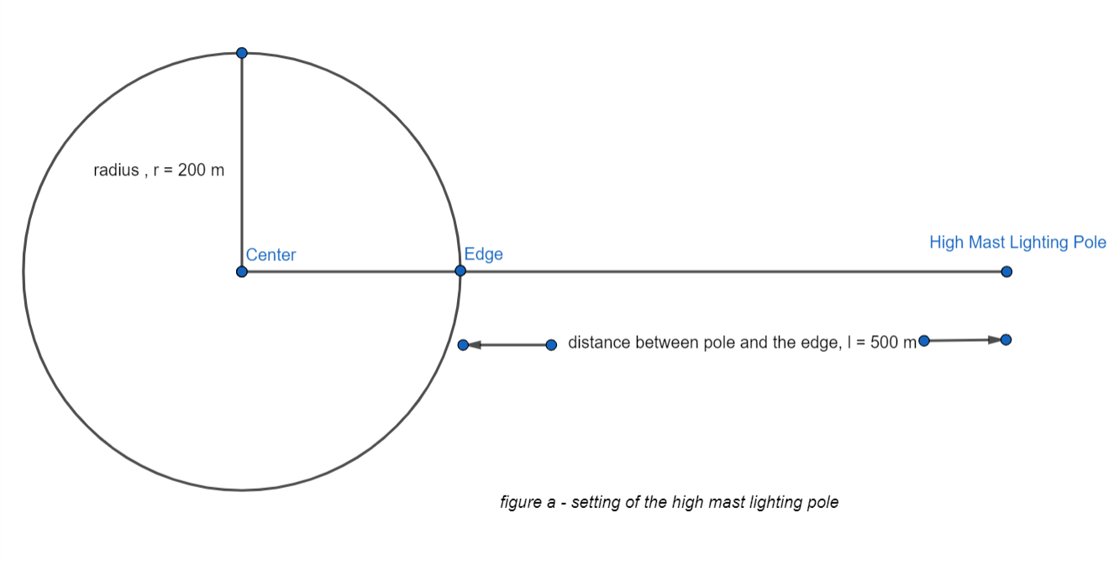
Working Methodology
Now we are going to demonstrate how the entire phase 01 is intended to be executed as per the present plan in the following processes,
Setting Up The High Mast Lighting Pole We will set the High Mast Lighting Pole at such a distance from the pre-located bombing area that the overall effects like heat, smoke, vibration, and others are minimized without losing the close surveillance of the thermal imaging system.

Slide 23
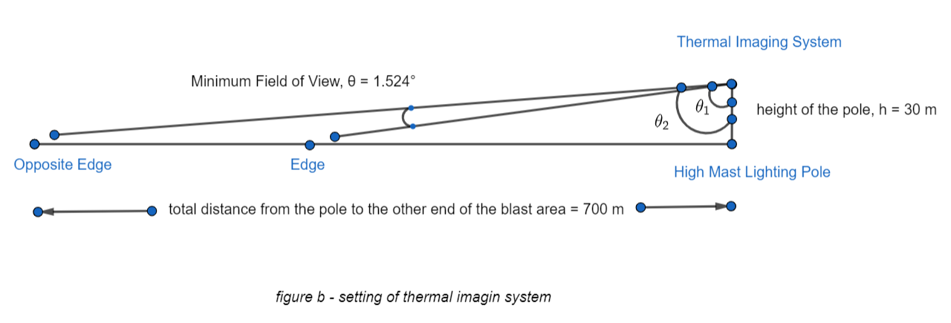
Positioning the Thermal Imaging System
Now we will safely place the thermal imaging system on top of the pole. This will give us the desired ground clearance which is necessary for the overall observation and tracking of the shell.

Slide 24
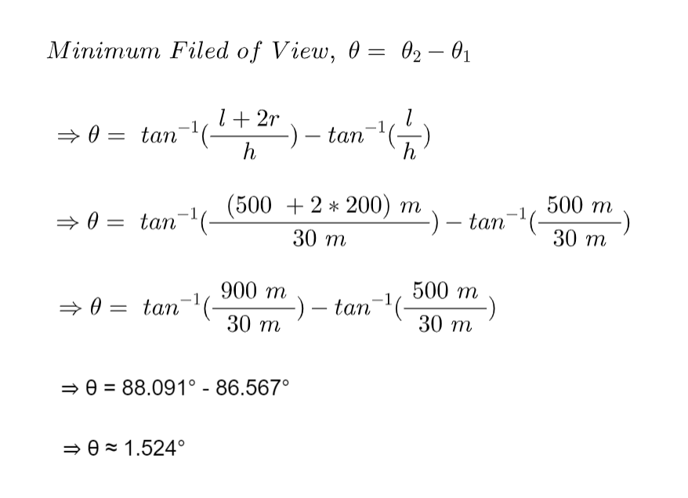

Slide 25
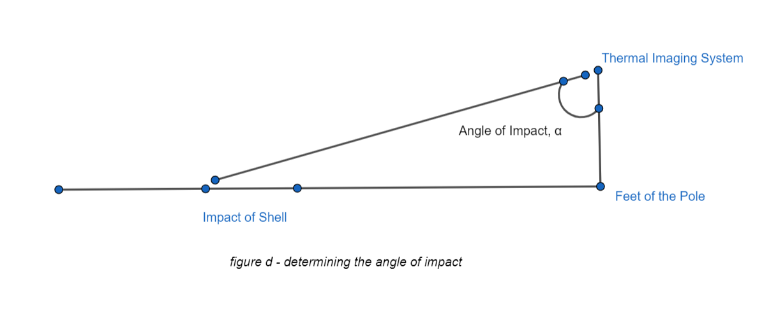
3. Calculating the average angle deviation per axis As our main focus is to determine the distance between the impact point and the pole’s feet known as the angle of impact denoted by α. Here the angle from the thermal camera to the impact point is very crucial.

Slide 26
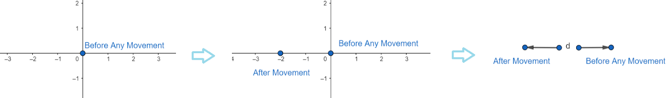
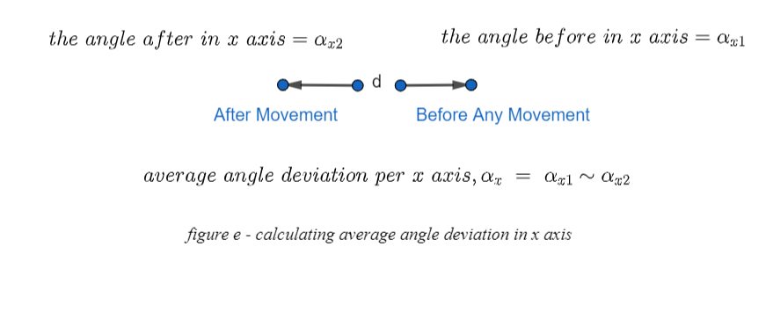

Slide 27
Capture the video of the falling shell As we are using a thermal camera that would be stationary. The main focus of the thermal imaging system should be such that the blast area is its main focus. Also, the field of view of these cameras is ample so the blast area must be at the center of the frame. Now the system will be in video mode as the shell is shot for the target. So from this, we will get the thermal footage for a single fire.
Modify the thermal video footage
As we are working with shells or some sort of missiles then we must consider the fact that they are having a great speed. That is why before proceeding to the next step we may have to slow the video. So that, in every frame we get a better localization of the thermally heated shell in the video frames. This step is a process that needs to be observed and analyzed in real-time for better performance.

Slide 28
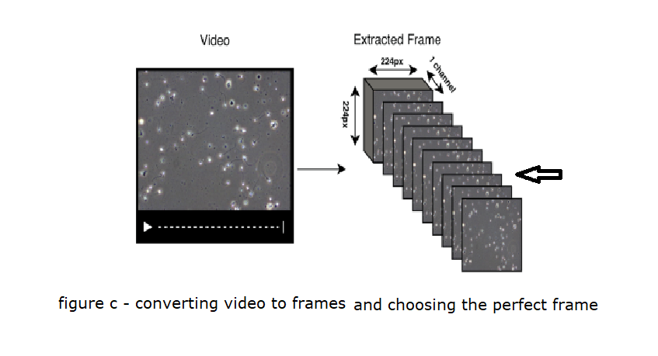
6. Convert the thermal video into single thermal frames Now the thermal video footage needs to be converted into thermal frames or single images. For that, we are using a technology called FFMPEG which is noted as a cross-platform solution for media conversions and specifically framing a video into single images. This will give us images of every time interval of the shell. In this way, we will be able to detect the shell at any given time just by observing the frame or the single picture of that time.

Slide 29
7. Choose the optimal frame of impact This time we are going to take the best thermal frame that is the impact point for the shell. Meaning just before the impact it could be a blast or a shell getting down into the soil or known as being blind, we will consider these two cases and we have to choose such a frame that is the accurate one. Here image processing and machine learning will help us greatly. Doing much processing we are now with the perfect frame that is best for our further processing.
8. Detect the shell in the perfect frame As we are using a thermal camera our video, as well as the chosen frame or image, will be a thermal image. So being a heated object, the fired shell’s heat signature is greater than the environment’s heat signature. Using this concept, we will try to detect the shell from that single frame. Here OpenCV will be very applicable. So by doing these we can easily detect the position of the shell in the frame.

Slide 30
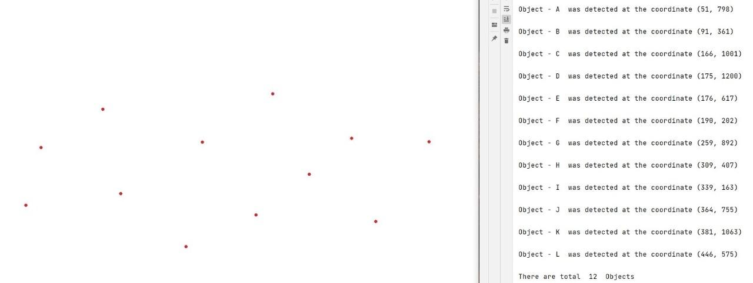
Detecting thermal points and their co-ordinates from a picture

Slide 31
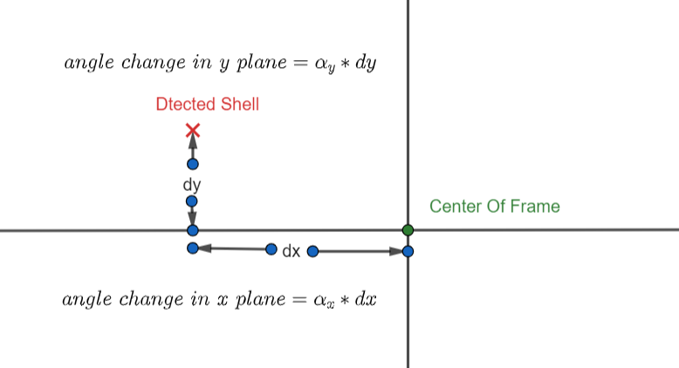
Determining the angle of impact from the chosen frame This time we are gonna determine the pixel location of the detected shell in the desired frame. After the localization, we have to check how much deviated from the center point of the entire frame. This deviation can be divided into 2 parts or axis as X-axis and Y-axis. So from these deviations, we can get to know how much change in the X-axis and how much change in the Y-axis has to be done. After we get these two modifications we can easily calculate the angle of impact for that particular shell, correcting from the main camera’s viewing angle.

Slide 32
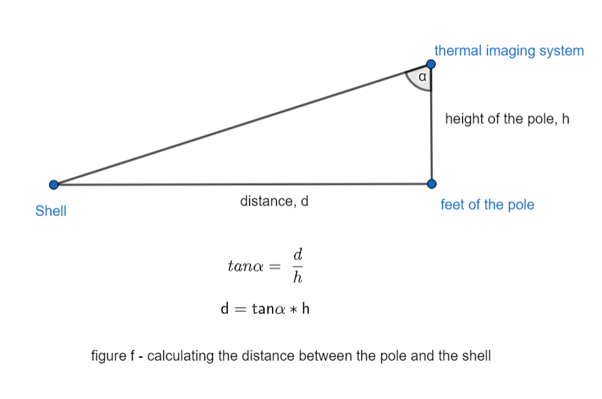
10. Calculating the distance from shell to pole Now as the height of the pole is fixed and we have got the angle of impact for the shell we can easily put some trigonometry and figure out the distance from the pole to the shell’s impact point. This math can be solved like the following picture.

Slide 33
11. Determining the GPS of the position of the impact point As we know the distance between a reference point (pole) and the impact point. So by knowing the GPS of the pole’s location or the thermal imaging system’s location or the point of reference we can easily get the direction using the compass and from those, we can determine the GPS of the impact point.
So by going through all these steps we can see how we can determine the GPS of the impact point which will be then given as feedback for the firing squad. This is a theoretical approach that we have planned which needs to be tested in real-time for the proper results and other modifications.

Slide 34
PURCHASE AND IMPLEMENTATION PLAN

Slide 35
COST:
a. Phase-1.
1) Cost Limitation. Our given budget is 500,000 BDT.
2) Cost Breakdown.
a) Thermal Camera.
3 * Ranger HRC (Total Approximately >= 500,000 BDT each). b) Pole.
3 * High Mast Lighting Pole (Total Approximately 100,000 BDT).

Slide 36
b. Phase-2.
1) Cost Breakdown.
a) Drone.
i) 1 * DJI MATRICE 300 RTK DRONE
(1,164,500 BDT).
Or
ii) 1 * DJI MAVIC 2 ENTERPRISE ADVANCED (590,039 BDT).
Both the drones exceed our budget limitation. However, considering hardware limitation DJI MATRICE 300 RTK is preferable.

Slide 37
b) Thermal Camera:
1 * DJI ZENMUSE XT (299,295 BDT)
c) Servers/ Terminals: Approximately
(200,000 BDT).
d) Total Cost: 1,663,795 BDT Approximately > 500,000 BDT.

Slide 38
CONCLUSION
To afford a UAV Based artillery fire guidance system which fulfills our requirements our budget is the biggest limitation. Therefore, either we need to increase the budget or we need to strip off the quality of the system to fit in the budget which is undesirable.

